Slide 1
Neural Semiconductor Limited
Normalization & ACID Properties
Presented By: Rudra, Hassan, Siddiqur & Noman
Trainee Software Engineers
Neural Semiconductor Limited

Slide 2

Table of contents:
Normalization
ACID Properties

Slide 3
Table of contents [Normalization]:
Normalization
Redundancy
Row level redundancy
Column level redundancy
Anomaly
Insert Anomaly
Delete Anomaly
Update Anomaly
Normalization Forms
1NF
2Nf
3NF
Examples

Slide 4
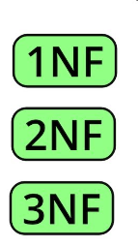
What is Normalization ?
Database Normalization is the process of structuring a database
to minimize redundancy and dependency
by dividing data into related tables.
This ensures
Data integrity,
Reduces anomalies, and
Improves efficiency in managing the data.

Slide 5
What is Normalization ?
Normalization divides larger tables into smaller tables and links them using relationships.
What does it do ? O_O
Purpose ? O_O
The purpose of Normalization is to eliminate redundant (useless) data and ensure data is stored logically.
Note (‾◡◝)
The inventor of the relational model E.F.Codd, proposed the theory of normalization.

Slide 6
Redundancy
Unnecessary duplication of data within the database.
When Occured ? O.O
It is occured when the same piece of information is stored in multiple places or repeated across various tables or rows, which can lead to several issues such as:
increased storage requirements,
data inconsistency, and
maintenance difficulties.
Types of Redundancy :
Row Level Redundancy & Column Level Redundancy

Slide 7
Row Level Redundancy
Example:
Redundant row values
Before Normalization
After Normalization
SID | Student Name | Age
1 | Jojo | 20
2 | Kit | 25
1 | Jojo | 20
SID | Student Name | Age
1 | Jojo | 20
2 | Kit | 25
If the SID is primary key of each row, we can restrict the insertion of same SID
Example: Row Level Redundancy

Slide 8
Column Level Redundancy
Example:
Similar information is stored in multiple columns of a table.
Redundant Column Values
*SID | Student name | Course id | Course name | Faculty id | Faculty name | Faculty Salary
1 | Abir | C1 | DBMS | F1 | Jonson | 30000
2 | Borhan | C2 | JAVA | F2 | Kabir | 50000
3 | Canan | C1 | DBMS | F1 | Jonson | 30000
4 | Dipta | C1 | DBMS | F3 | Gorge | 40000
Example: Column Level Redundancy

Slide 9
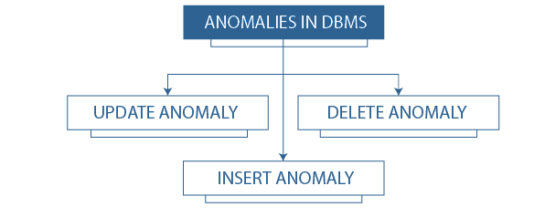
What is an Anomaly?
Refers to problems that can occur in poorly planned, unnormalized databases where all the data is stored in one table (a flat-file database).
Example: Anomaly

Slide 10
Anomalies in DBMS
Insert Anomaly :
certain attributes cannot be inserted into the database
without the presence of other attributes.
Delete Anomaly:
exists when certain attributes are lost
because of the deletion of other attributes.
Update Anomaly:
exists when changing of one instance of data,
requires changes on multiple places

Slide 11
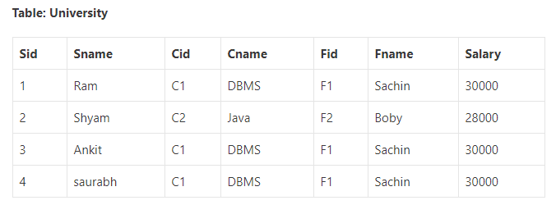
Anomaly Example
Below table University consists of seven attributes:
Sid[Student id], (primary key)
Sname[Student Name],
Cid [course id],
Cname[course name],
Fid[Faculty Id],
Fname[Faculty Name], and Salary.
*
For this scenario each student can only enroll to a single course

Slide 12
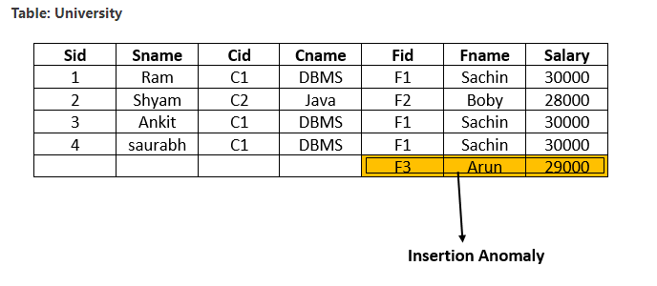
Insertion Anomaly
Suppose a new faculty joins the University, and the Database Administrator inserts the faculty data into the above table. But he is not able to insert because Sid is a primary key, and can’t be NULL. So this type of anomaly is known as an insertion anomaly.

Slide 13
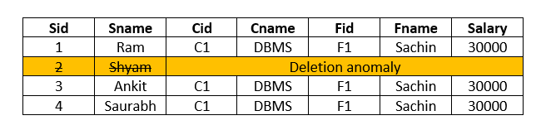
Delete Anomaly
When the Database Administrator wants to delete the student details of Sid=2 from the above table, then it will delete the faculty and course information too which cannot be recovered further.
SQL:
DELETE FROM University WHERE Sid=2;

Slide 14
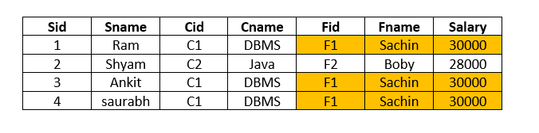
Update Anomaly
When the Database Administrator wants to change the salary of faculty F1 from 30000 to 40000 in above table University, then we need to update fields more than one row. So, this is an update anomaly in a table.
SQL:
UPDATE University SET Salary= 40000 WHERE Fid=“F1”;
To remove all these anomalies, we need to normalize the data in the database.

Slide 15
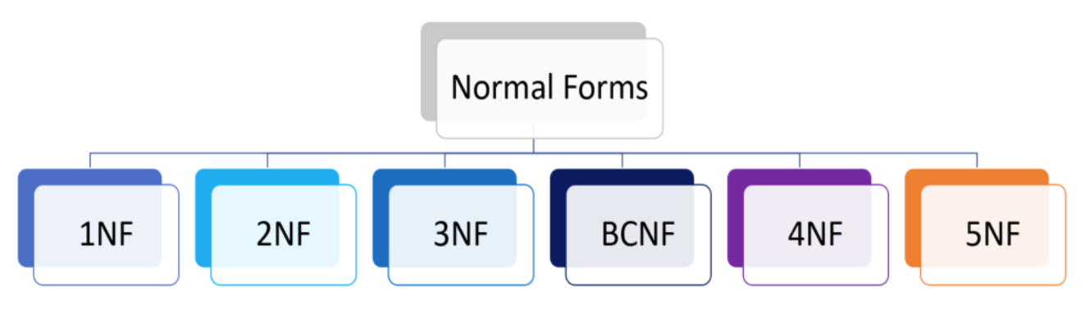
Normal forms
In a DBMS, normal forms are levels of organization for data that help minimize redundancy and undesirable characteristics.

Slide 16
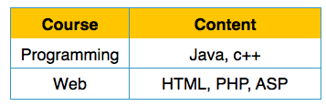
First Normal Form (1NF)
According to the E.F. Codd, a relation will be in 1NF, if each cell of a relation contains only an atomic value.
Example: 1st Normal Form
The following Course_Content relation is not in 1NF because the Content attribute contains multiple values.

Slide 17
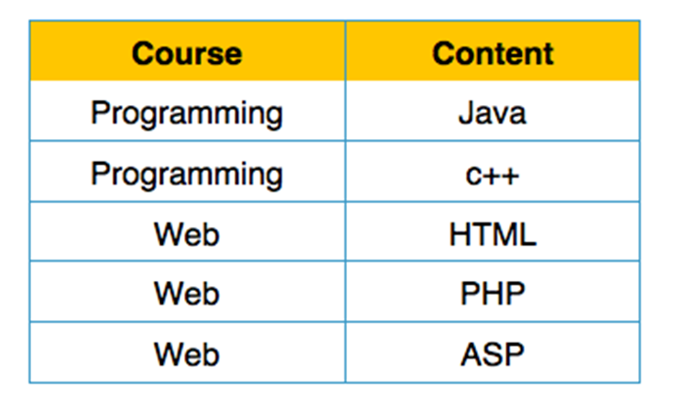
1NF Example (Cont..)
Example: 1st Normal Form
The below relation student is in 1NF:

Slide 18
Rules of 1NF
The qualifications for 1NF are:
Each column name must be unique.
Each attribute value must be single.
3. Each row must be unique.
4. Choose a primary key.
Course | Content
Programming | java
Web | php
Programming | java
Course | Content | Content
Course | Content
Programming | java
Programming | css
Web | html
Web | php
Course | Content
Programming | java, CSS
Web | html, php
id (primary key) | Course | Content
1 | Programming | java
2 | Web | php
3 | Programming | html
id | Course | Content
1 | Programming | java
2 | Web | php
3 | Programming | html

Slide 19
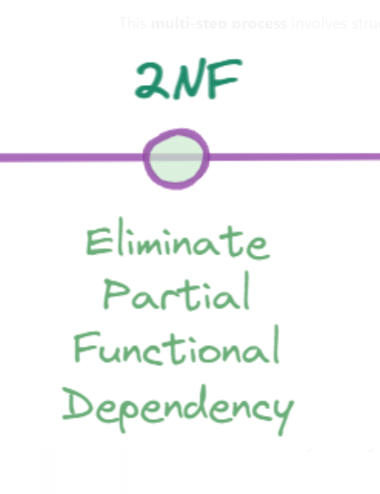
Second Normal Form (2NF)
According to the E.F. Codd, a relation is in 2NF, if it satisfies the following conditions:
The table should be in the First Normal Form.
There should be no Partial Dependency.

Slide 20
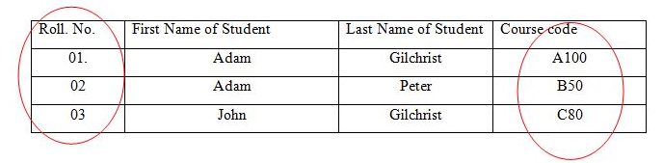
Prime and Non Prime Attributes
Prime attributes: The attributes which are used to form a candidate key are called prime attributes.
Non-Prime attributes: The attributes which do not form a candidate key are called non-prime attributes.
Prime Attribute: Roll No., Course Code
Non-Prime Attribute: First Name of Student, Last Name of Student

Slide 21
Functional Dependency
A dependency FD: X → Y means that the values of Y are determined by the values of X. Two tuples sharing the same values of X will necessarily have the same values of Y.
We illustrate this as:
X🡪 Y (read as: X determines Y or Y depends on X)

Slide 22
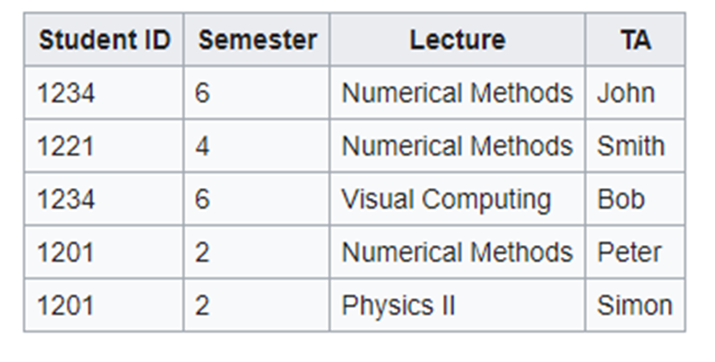
Functional Dependency
Whenever two rows in this table feature the same StudentID, they also necessarily have the same Semester values. This basic fact can be expressed by a functional dependency:
StudentID → Semester.

Slide 23
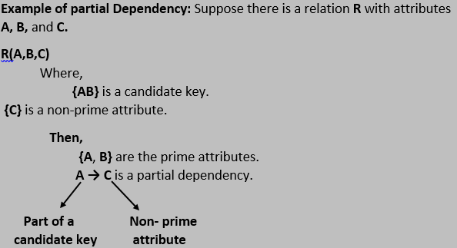
Partial Dependency
If a non-prime attribute can be determined by the part of the candidate key in a relation, it is known as a partial dependency.

Slide 24
Second Normal Form (2NF) [RECAP]
According to the E.F. Codd, a relation is in 2NF, if it satisfies the following conditions:
The table should be in the First Normal Form.
There should be no Partial Dependency.

Slide 25
2NF Example
Course-Semester Table
CourseId | SemesterId | CourseName | Num Student
In Student_Project relation, prime key attributes are CourseId, SemesterId
According to 2nf conformity, non-key attributes, i.e.Num student and Course Name should be dependent on both candidate key attributes as a whole S
But here:
CourseId → CourseName,
SemesterId, CourseId → Num student
Candidate Keys: {CourseId, SemesterId}
Non-prime attribute: {Num student, CourseName}

Slide 26
2NF Example (Cont..)
We broke the relation in two as depicted in the above picture. So there exists no partial dependency.
Course-Semester
CourseId | SememsterId | Num Student
Course
CourseId | Course Name

Slide 27
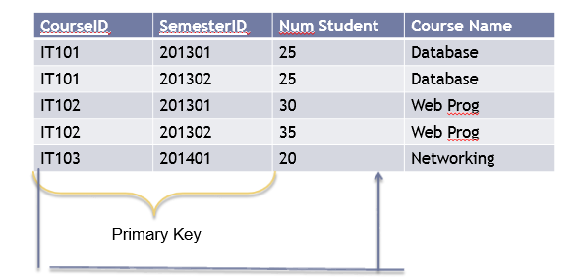
Example 2NF
Problem
The Course Name depends on only CourseID, a part of the primary key not the whole primary key{CourseID, SemesterID}.It’s called partial dependency.
Solution
Remove CourseID and Course Name together to create a new table.

Slide 28
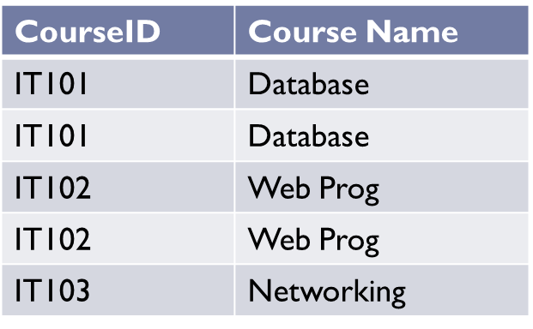
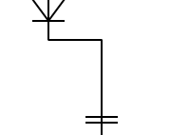
Example 2NF (Cont..)
CourseID | SemesterID | Num Student
IT101 | 201301 | 25
IT101 | 201302 | 25
IT102 | 201301 | 30
IT102 | 201302 | 35
IT103 | 201401 | 20
Done?
CourseID | Course Name
IT101 | Database
IT102 | Web Prog
IT103 | Networking
Oh no, it is still not in 1NF yet. Remove the repeating groups too.
Finally, connect the relationship.

Slide 29
Benefits of 2NF
Problems thsose 2nf solves:
Data Redundancy:
If a table contains partial dependencies, the same data can be repeated multiple times across rows. This leads to unnecessary duplication, increasing storage usage and maintenance effort
Anomalies:
reducing chances of update, delete, insert anomalies
Inefficient Data Management:
Since non-key attributes depend only on part of the composite key, the structure becomes inefficient for managing and querying data

Slide 30
Third Normal Form(3NF)
Third Normal Form (3NF) is a level of database normalization, which ensures:
It should already be in the Second Normal form.
It should not have Transitive Dependency.
Ensure that no non-prime attribute depends on another non-prime attribute.
Note: All transitive dependencies are removed to place in another table.

Slide 31
What is Transitive Dependency ??
A non-prime attribute is transitively dependent on another non-prime attribute , which in turn depends on the primary key.
X -> Z is a transitive dependency if the following three functional dependencies hold true:
X🡪 Y (read as: X determines Y or Y depends on X)
Y🡪 Z (read as: Y determines Z or Z depends on Y)
Y🡪 X (read as: Y can not determines X or X doesn’t depend on Y)

Slide 32
Transitive Dependency(Cont..)
Example
Book -> Author (if we know the book, we knows the author name)
{Author} does not -> Book
{Author} -> {Author_age}
Therefore as per the rule of transitive dependency: {Book} -> {Author_age} should hold, that makes sense because if we know the book name we can know the author’s age.
*Book | Author | Author_age
Windhaven | George R. R. Martin | 66
Harry Potter | J. K. Rowling | 49
Dying of the Light | George R. R. Martin | 66

Slide 33
So what? :( What is the issue if we have Transitive Dependency?
Transitive dependencies can lead to data redundancy and update anomalies because changes to non-prime attributes may need to be applied in multiple places.
Suppose, Initial Table (Not in 3NF):
*EmployeeID | EmployeeName | Department | Department Head
1 | Alice | HR | Bob
2 | Charlie | IT | Dave
3 | Eva | HR | Bob

Slide 34
Suppose, Initial Table (Not in 3NF):
*EmployeeID | EmployeeName | Department | Department Head
1 | Alice | HR | Bob
2 | Charlie | IT | Dave
3 | Eva | HR | Bob
Primary Key: EmployeeID
Non-prime Attributes: EmployeeName, Department, Department Head
Transitive Dependency:
Department Head depends on Department, and Department depends on EmployeeID. Thus, Department Head is transitively dependent on EmployeeID.

Slide 35
Suppose, Initial Table (Not in 3NF):
*EmployeeID | EmployeeName | Department | Department Head
1 | Alice | HR | Bob
2 | Charlie | IT | Dave
3 | Eva | HR | Bob
Problems:
Data Redundancy - Both Alice and Eva have HR as their department and share the same Department Head (Bob). This information is repeated, leading to redundancy.
Update Anomalies - If Bob leaves, you must update every occurrence of Department Head for HR in the table, which is error-prone and inefficient.

Slide 36
Convert to 3NF:
Employee Table:
*EmployeeID | EmployeeName | Department
1 | Alice | HR
2 | Charlie | IT
3 | Eva | HR
Department Table:
*Department | Department Head
HR | Bob
IT | Dave

Slide 37
Example Table
StudentID is the primary key.
Is it 1NF?
How can you make it 1NF?
First Normal Form (1NF)
Ensures that the table has a primary key and that all attributes contain only atomic (indivisible) values.
Each column should hold a single value, and each row should be unique.
*StudentID | StudentName | Address | HouseName | HouseColor | Subject | SubjectCost | Grade
19594332X | Mary Watson | 10 Charles Street | Bob | Red | English Math Info Tech | $50 $50 $100 | B A B+

Slide 38

Example 1 (Cont..)
Create new rows so each cell contains only one value
But now the studentID no longer uniquely identifies each row. You now need to declare studentID and subject together to uniquely identify each row. So the new key is StudentID and Subject.
Is it 2NF?

Slide 39
Create new rows so each cell contains only one value
*StudentID | StudentName | Address | HouseName | HouseColor | *Subject | SubjectCost | Grade
19594332X | Mary Watson | 10 Charles Street | Bob | Red | English | $50 | B
19594332X | Mary Watson | 10 Charles Street | Bob | Red | Math | $50 | A
19594332X | Mary Watson | 10 Charles Street | Bob | Red | Info Tech | $100 | B+
But now the studentID no longer uniquely identifies each row. You now need to declare studentID and subject together to uniquely identify each row. So the new key is StudentID and Subject.
Is it 2NF?

Slide 40
And 2NF requires
All non-key fields are dependent on the ENTIRE key (studentID + subject)
No partial dependancy
StudentName and Address are dependent on studentID (which is part of the key) This is good. But they are not dependent on Subject (the other part of the key)

Slide 41
Solution ?
Make new tables
Make a new table for each primary key field
Give each new table its own primary key
Move columns from the original table to the new table that matches their primary key…

Slide 42
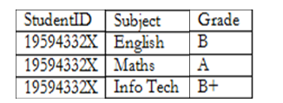

Example (Cont..)
STUDENT TABLE (key = StudentID)
RESULTS TABLE (key = StudentID+Subject) SUBJECTS TABLE (key = Subject)
But is it 3NF?

Slide 43
STUDENT TABLE (key = StudentID)
RESULTS TABLE (key = StudentID+Subject) SUBJECTS TABLE (key = Subject)
*StudentID | StudentName | Address | HouseName | HouseColor
19594332X | Mary Watson | 10 Charles Street | Bob | Red
*StudentID | *Subject | Grade
19594332X | English | B
19594332X | Math | A
19594332X | Info Tech | B+
*Subject | SubjectCost
English | $50
Math | $50
Info Tech | $100
But is it 3NF?

Slide 44
STUDENT TABLE (key = StudentID)
*StudentID | StudentName | Address | HouseName | HouseColor
19594332X | Mary Watson | 10 Charles Street | Bob | Red
Here,
HouseColour is dependent on HouseName, HouseName is dependent on StudentID
But either way, non-key fields are dependent on MORE THAN THE PRIMARY KEY (studentID). And 3NF says that non-key fields must depend on nothing but the key

Slide 45
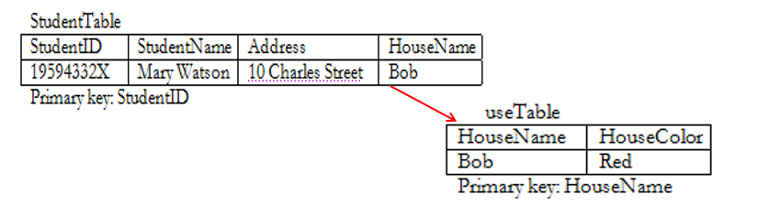
Example 1 (Cont..)

Slide 46
*StudentID | StudentName | Address | HouseName
19594332X | Mary Watson | 10 Charles Street | Bob
*HouseName | HouseColor
Bob | Red

Slide 47
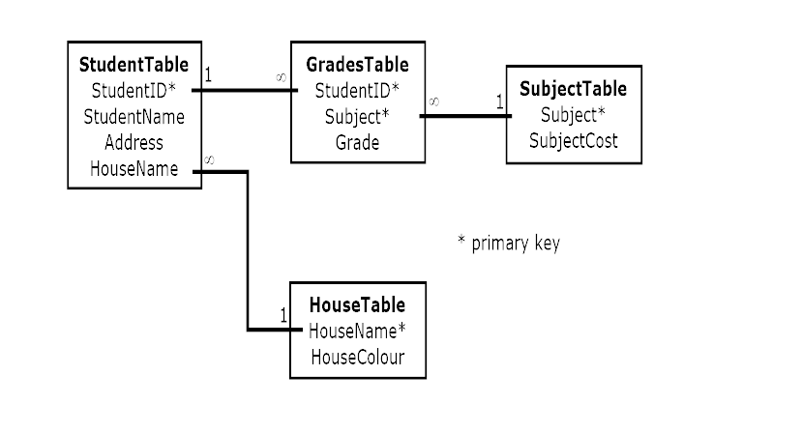
The Final Scheme

Slide 48
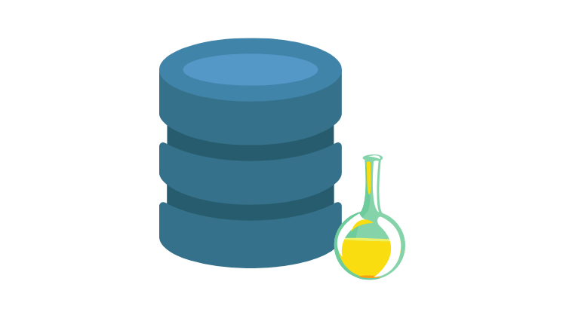
ACID
Atomicity, Consistency, Isolation and Durability in
Relational Database Systems

Slide 49
Agenda
What is a Transaction?
Atomicity
Isolation
Consistency
Durability
Quiz

Slide 50

What is a Transaction?
A transaction is a sequence of one or more operations executed as a single, indivisible unit of work. It ensures that either all operations are completed successfully, or none are applied, maintaining system integrity and consistency.

Slide 51
Transaction
A collection of queries
One unit of work
E.g. Account deposit (SELECT, UPDATE, UPDATE)

Slide 52
Transaction Lifespan
Transaction BEGIN
Transaction COMMIT
Transaction ROLLBACK
Transaction unexpected ending = ROLLBACK (e.g. crash)

Slide 53
Nature of Transactions
Usually Transactions are used to change and modify data
However, it is perfectly normal to have a read only transaction
Example, you want to generate a report and you want to get consistent snapshot based at the time of transaction

Slide 54
Transaction
ACCOUNT_ID | BALANCE
1 | $1000
2 | $500
$900
$900
Send $100 From Account 1 to Account 2
$600
$600
BEGIN TX1
SELECT BALANCE FROM ACCOUNT WHERE ID = 1
BALANCE > 100
UPDATE ACCOUNT SET BALANCE = BALANCE - 100 WHERE ID = 1
UPDATE ACCOUNT SET BALANCE = BALANCE + 100 WHERE ID = 2
COMMIT TX1

Slide 55
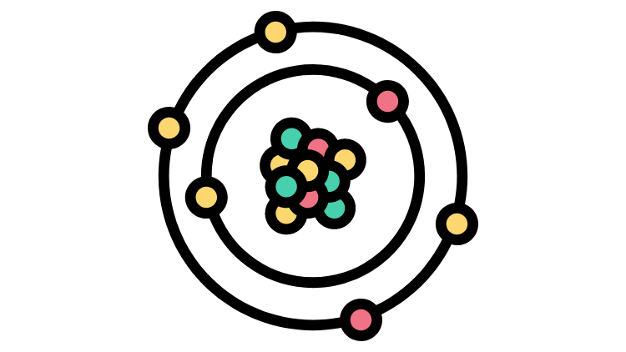
Atomicity
Atomicity ensures that a series of operations in a transaction are completed fully or not at all. This means either all parts of the transaction succeed together, or if any part fails, the entire transaction is rolled back, preserving system integrity.

Slide 56
Atomicity
All queries in a transaction must succeed.
If one query fails, all prior successful queries in the transaction should rollback.
If the database went down prior to a commit of a transaction, all the successful queries in the transactions should rollback

Slide 57
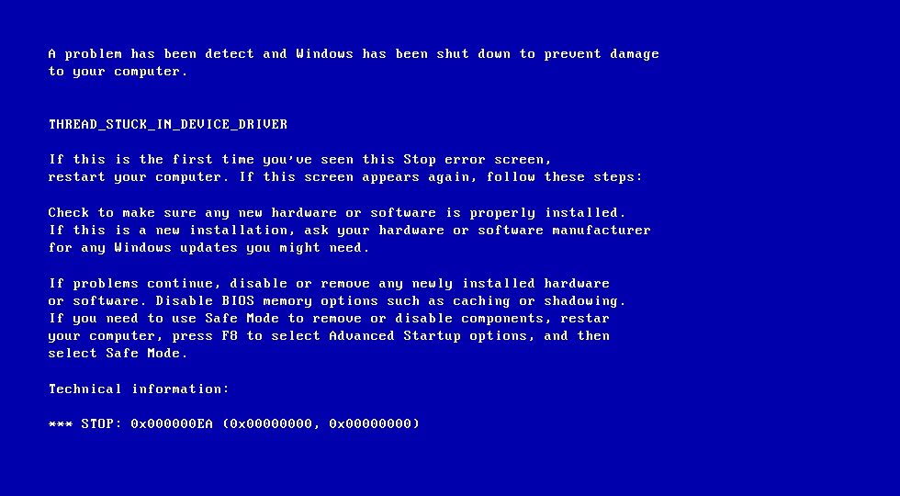
Atomicity
ACCOUNT_ID | BALANCE
1 | $1000
2 | $500
$900
Send $100 From Account 1 to Account 2
BEGIN TX1
SELECT BALANCE FROM ACCOUNT WHERE ID = 1
BALANCE > 100
UPDATE ACCOUNT SET BALANCE = BALANCE - 100 WHERE ID = 1

Slide 58
Atomicity
ACCOUNT_ID | BALANCE
1 | $900
2 | $500
After we restarted the machine the first account has been debited but the other account has not been credited.
This is really bad as we just lost data, and the information is inconsistent
An atomic transaction is a transaction that will rollback all queries if one or more queries failed.
The database should clean this up after restart.

Slide 59

Isolation

Slide 60
Contents
Isolation
Concurrency
Read Phenomena
Dirty Reads
Non-repeatable Reads
Phantom Reads
Isolation Level
Read Uncommitted
Read Committed
Repeatable Read
Serializable
Snapshot

Slide 61
Isolation
Isolation ensures that multiple transactions can occur concurrently without leading to the inconsistency of the database state. Transactions occur independently without interference.
Why Isolation is Necessary?
Concurrency in Databases: Multiple transactions may run concurrently in a multi-user environment.
Consistency: Guarantees that the database remains in a consistent state even with multiple concurrent operations.

Slide 62
Concurrency
Concurrency refers to the ability to execute multiple transactions simultaneously. Each transaction operates independently but might interact with the same data.
Why Concurrency is Necessary?
Increased Throughput
Improved Resource Utilization
Concurrency Control Problem (Read Phenomena)
Dirty Reads
Non-repeatable Reads
Phantom Reads

Slide 63
Read Phenomena -Dirty Reads
A dirty read occurs when a transaction reads data that has been modified by another transaction but not yet committed.
Uncommitted Data: It involves reading data that may not be final.
Consequences
Incorrect Results: If the data read is later rolled back, the first transaction might make decisions based on incorrect or temporary data.
Inconsistent Database State: Dirty reads can lead to an inconsistent view of the database.

Slide 64
Dirty Reads
BEGIN TX1
BEGIN TX2
SELECT id, name, balance FROM accounts;
ID | Name | Balance
1 | Alice | 1000
2 | Bob | 2000
UPDATE accounts SET balance = balance + 500 WHERE id = 1;
ID | Name | Balance
1 | Alice | 1500
2 | Bob | 2000
SELECT id, name, balance FROM accounts WHERE id = 1;
ID | Name | Balance
1 | Alice | 1500
COMMIT TX1
ROLLBACK TX2

Slide 65
Read Phenomena - Non Repeatable Reads
A non-repeatable read occurs when a transaction reads the same data more than once and gets different values.
Multiple Reads with Different Results: The same query within the same transaction returns different results due to concurrent updates.
Consequences
Inconsistent View of Data: A transaction sees different versions of data within its own scope.
Incorrect Processing: A transaction might make decisions based on outdated data, causing errors in calculations or operations.

Slide 66
Non-repeatable Reads
BEGIN TX1
BEGIN TX2
SELECT id, name, balance FROM accounts;
ID | Name | Balance
1 | Alice | 1000
2 | Bob | 2000
UPDATE accounts SET balance = balance + 500 WHERE id = 1;
ID | Name | Balance
1 | Alice | 1500
2 | Bob | 2000
COMMIT TX2
SELECT id, name, balance FROM accounts WHERE id = 1;
ID | Name | Balance
1 | Alice | 1500
COMMIT TX1

Slide 67
Read Phenomena - Phantom Reads
Phantom reads occur when a transaction reads data that was inserted or deleted by another transaction after the first transaction started but before it finished.
Additional or Missing Rows: The same query executed within a transaction may return a different number of rows due to inserts or deletes by other transactions.
Consequences
Unpredictable Query Results: A transaction might see different sets of data on multiple executions of the same query within the same transaction.
Incorrect Processing: Logical errors can arise if the transaction assumes the set of rows remains constant while other transactions are modifying the dataset.

Slide 68
Phantom Reads
BEGIN TX1
BEGIN TX2
SELECT id, name, balance FROM accounts;
ID | Name | Balance
1 | Alice | 1000
2 | Bob | 2000
INSERT INTO accounts VALUES
(3, ‘Carol’, 3000);
ID | Name | Balance
1 | Alice | 1000
2 | Bob | 2000
3 | Carol | 3000
COMMIT TX2
SELECT SUM(balance) FROM accounts;
SUM (balance)
6000
COMMIT TX1

Slide 69
Isolation Level - Read Uncommitted
Read Uncommitted is the lowest isolation level, where a transaction can read data that has been modified by another transaction but not yet committed.
No Isolation: Transactions are not isolated from each other, meaning they can see uncommitted changes made by other transactions.
Higher Concurrency: Since transactions don’t need to wait for locks or commit confirmation, it allows for greater concurrency.
Higher Risk of Anomalies: Read Uncommitted allows all types of anomalies: dirty reads, non-repeatable reads, and phantom reads.

Slide 70
Isolation Level - Read Committed
Read Committed is an isolation level that ensures a transaction can only read data that has been committed by other transactions.
Prevents Dirty Reads: Transactions can only read committed data ensuring no temporary data is accessed.
Allows Non-Repeatable Reads: A transaction can read a value, then another transaction can change and commit the same value, and when the first transaction reads it again, it gets a different result.

Slide 71
Read Committed Prevents Dirty Read But Can’t Prevent Non-Repeatable Read
BEGIN TX1
BEGIN TX2
SELECT id, name, balance FROM accounts;
ID | Name | Balance
1 | Alice | 1000
2 | Bob | 2000
UPDATE accounts SET balance = balance + 500 WHERE id = 1;
ID | Name | Balance
1 | Alice | 1500
2 | Bob | 2000
SELECT id, name, balance FROM accounts WHERE id = 1;
ID | Name | Balance
1 | Alice | 1000
Prevents dirty read
COMMIT TX2
SELECT id, name, balance FROM accounts WHERE id = 1;
ID | Name | Balance
1 | Alice | 1500
Can’t prevent non-repeatable read
COMMIT TX1

Slide 72
Isolation Level - Repeatable Read
Repeatable Read ensures if a transaction reads a row of data, subsequent reads of the same row within the same transaction will return the same data.
Prevents Non-Repeatable Reads: Once a transaction reads a value, it won’t see any modifications to that data by other transactions for the duration of the transaction.
Allows Phantom Reads: Although it ensures consistency in individual rows, it doesn't prevent new rows from being inserted or deleted by other transactions, which can lead to phantom reads.

Slide 73
Repeatable Read Prevents Non-repeatable Read
BEGIN TX1
BEGIN TX2
SELECT id, name, balance FROM accounts;
ID | Name | Balance
1 | Alice | 1000
2 | Bob | 2000
UPDATE accounts SET balance = balance + 500 WHERE id = 1;
Rows Locked
Blocked
SELECT id, name, balance FROM accounts WHERE id = 1;
ID | Name | Balance
1 | Alice | 1000
COMMIT TX1
Unblocked (Query Executed)
ID | Name | Balance
1 | Alice | 1500
COMMIT TX2

Slide 74
Repeatable Read Can’t Prevent Phantom Read
BEGIN TX1
BEGIN TX2
SELECT id, name, balance FROM accounts WHERE balance > 500;
ID | Name | Balance
1 | Alice | 1000
2 | Bob | 2000
INSERT INTO accounts VALUES
(1, ‘Carol’, 3000);
ID | Name | Balance
1 | Alice | 1000
2 | Bob | 2000
3 | Carol | 3000
Rows Locked
COMMIT TX2
SELECT SUM(balance) FROM accounts WHERE
balance > 500;
SUM (balance)
6000
Expected 3000, but got 6000 ‘Phantomly’
COMMIT TX1

Slide 75
Isolation Level - Serializable
Serializable ensures complete isolation from other transactions. It behaves as if all transactions are executed serially (one after the other) rather than concurrently.
How It Solves Phantom Reads
Preventing Inserts: Other transactions will be blocked from inserting new rows with balance > 500 because the range (500, ∞) is locked.
Preventing Deletes and Updates: Other transactions will also be blocked from updating or deleting rows that would affect the query result set.
Downside
Lower Concurrency: Serializable transactions often require locking large sets of data, which can significantly reduce system performance and concurrency.

Slide 76
Isolation Level - Snapshot
Snapshot Isolation uses a versioning approach. Instead of locking rows, it ensures that each transaction works with a consistent snapshot of the database.
How It Solves Phantom Reads
A transaction sees a snapshot of the data as it existed at the beginning of the transaction.
Other transactions can still insert, update, or delete rows, but the current transaction will not see these changes.
Downside
Write Skew: Concurrent transactions make conflicting updates that don’t directly impact the snapshot but could lead to inconsistencies when both transactions are committed.

Slide 77
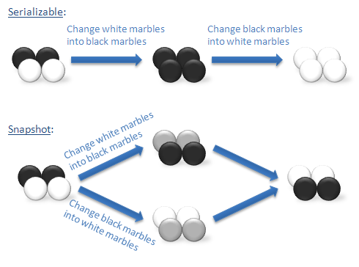
Serializable VS Snapshot
Serializable
Transaction 1: Changes White to Black and locks the rows.
Transaction 2: Changes Black to White and locks the rows.
Snapshot
Transaction 1: Changes White to Black in its snapshot.
Transaction 2: Changes Black to White in its snapshot.
N.B. If they try to update the same row, Snapshot Isolation would detect a conflict at commit time and throw an error.

Slide 78
Snapshot Isolation
ID | Color
1 | Black
2 | Black
3 | White
4 | White
ID | Color
1 | White
2 | White
3 | Black
4 | Black
(Swapped)
BEGIN TX1
BEGIN TX2
UPDATE marbles SET color = ‘Black’ WHERE
color = ‘White’;
UPDATE marbles SET color = ‘White’ WHERE color = ‘Black;
COMMIT TX2
COMMIT TX1

Slide 79
Isolation Level - Use Case
Serializable
Bank Transfer System
Ensuring no inconsistent account balances.
Scenario
Multiple transactions may occur concurrently. The system must ensure that when a transfer is being processed, no other transaction should interfere with the involved accounts until the transfer is complete, ensuring data consistency.
Snapshot
Version-Controlled Systems
Software development platforms (e.g., Git).
Scenario
Developers work on their own branch or version of code without seeing or being affected by changes made to other branches until they decide to merge changes. If conflicts arise during the merge, they are resolved at that point, ensuring data integrity.

Slide 80
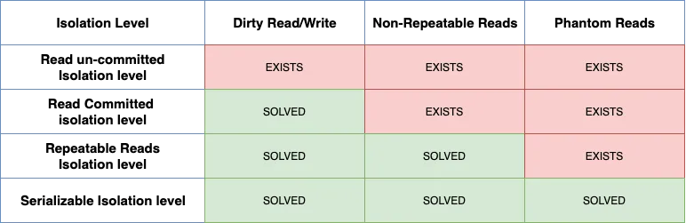
Isolation Levels vs Read Phenomena

Slide 81
Table of Contents
1. Consistency in ACID Properties
Definition of Consistency in Databases
Consistency Models in Distributed Databases
Strong Consistency
Eventual Consistency
2. Durability in ACID Properties
Definition of Durability in Databases
Techniques for Ensuring Durability
Write-Ahead Logging (WAL)
Snapshotting (Asynchronous Snapshots)
Append-Only File (AOF) Logging

Slide 82

Consistency

Slide 83
Consistency
Definition: Consistency ensures that a database moves from one valid state to another valid state after a transaction. Any transaction will leave the database in a consistent state, where all data integrity rules (constraints, triggers, etc.) are satisfied.
Example: Suppose there is a constraint that an account balance cannot go negative. Consistency ensures that after a transaction, even if some operations were performed, the final state of the database doesn't violate this rule (e.g., no account has a negative balance).

Slide 84
Importance of Consistency
Data Integrity: Ensures the database remains valid and accurate throughout transactions. It prevents invalid or corrupt data from entering the system, maintaining data purity.
Integrity Constraints: Integrity Constraints are the protocols that a table's data columns must follow which guarantees that key constraints like primary keys, foreign keys, unique constraints are enforced, ensuring correct relationships and data validity. These constraints maintain valid relationships and data accuracy, preventing the existence of orphan records.
Reliable Results: Provides users with accurate and trustworthy results by ensuring the data is consistent and correct, regardless of the operations performed on the database.
Business Rule Enforcement: Ensures that business-specific rules (user-defined constraints) are applied correctly to the data, reflecting business logic and policies.

Slide 85
Mechanisms Ensuring Data Consistency in Database Systems
Constraint Type | Description | Example in Banking System
Domain Integrity | Ensures column data follows the defined domain. | account_balance DECIMAL(10, 2) CHECK (account_balance >= 0) (balance can't be negative)
Entity Integrity | Ensures each row is uniquely identifiable. | account_number INT PRIMARY KEY (each account has a unique number)
Referential Integrity | Ensures relationships between tables are valid. | customer_id INT REFERENCES customers(customer_id) (valid customer references)
User-Defined Integrity | Enforces additional business rules specific to the domain. | CHECK (withdrawal_amount <= account_balance) (can't withdraw more than balance)
Atomicity | Ensures that a transaction is all-or-nothing. | If a bank transfer fails, the withdrawal and deposit are rolled back, keeping accounts consistent.
Isolation | Ensures transactions do not interfere with each other. | Two customers booking the same seat on a flight won't interfere due to transaction isolation.

Slide 86
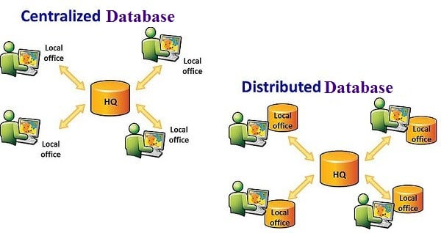
What is a Distributed Database System?
A Distributed Database System (DDBS) is a database system where data is stored and managed across multiple physical locations or nodes. Despite this distribution, the system abstracts the complexity and presents itself as if it were a single, unified local database.

Slide 87
Consistency in Distributed Systems
Consistency Models
A Consistency Model is a set of rules that defines how data operations (such as reads and writes) behave in a distributed system, particularly in terms of visibility
Some Type of Consistency Models
Strong Consistency
Eventual Consistency

Slide 88
Strong Consistency
Definition: Strong Consistency ensures that after a transaction is committed, all nodes in the system immediately reflect the latest changes. This means that all nodes will show the same data at any given time.
How It Works:
Synchronization: When a transaction is completed, all nodes are updated at the same time or in a coordinated way to ensure they all reflect the new data.
Read Operations: After a transaction is committed, all subsequent reads will show the most recent data without any delay.
Coordination Protocols: Techniques like Two-Phase Commit (2PC - Prepare and Commit) and Three-Phase Commit (3PC - Prepare, Pre - Commit and Commit) are used to make sure all nodes agree on the changes.
Example:
Traditional Relational Databases like PostgreSQL and MySQL provide strong consistency, ensuring that once a transaction is committed, all users immediately see the updated data.
Use Case: Typical banking system follows strong consistency. Some banks use hybrid consistency, combining elements of strong consistency with other models like eventual consistency to balance performance

Slide 89
Strong Consistency (Pros and Cons)
Advantages:
Data Accuracy: Users always see the most recent data, ensuring that there are no discrepancies.
Simplified Programming Model: Developers do not need to handle inconsistencies or delays in data visibility.
Disadvantages:
Performance Impact: Synchronizing all nodes can be resource-intensive and may lead to performance bottlenecks.
Scalability Challenges: Maintaining strong consistency across a large number of nodes can be challenging due to network latency and coordination overhead.

Slide 90
Eventual Consistency
Definition: Eventual Consistency allows for temporary inconsistencies between nodes but guarantees that, over time, all nodes will converge to the same data state. This model prioritizes availability and performance over immediate consistency.
How It Works:
Asynchronous Updates: When a transaction is committed, updates are propagated to other nodes asynchronously. Nodes might not see the changes immediately, but eventually, all nodes will have the same data.
Example:
NoSQL Databases: Databases like Amazon DynamoDB, Apache Cassandra use eventual consistency models to provide high availability and performance in distributed environments.
Use Case: Social media use eventual consistency to maintain their database as the information is less important and number of users and database are huge.

Slide 91
Eventual Consistency (Pros and Cons)
Advantages:
High Availability: The system remains highly available and responsive even if some nodes are temporarily inconsistent.
Scalability: Easier to scale out to many nodes since updates do not require immediate synchronization across all nodes.
Disadvantages:
Staleness: Reads may return stale data, as updates might not be visible immediately.

Slide 92

Durability

Slide 93
Durability
Definition: Durability guarantees that once a transaction is committed, the changes made by the transaction are permanent, even in the event of a system failure (like a crash). This means that committed data will not be lost.
Example: After successfully transferring money between two accounts and committing the transaction, even if the system crashes immediately afterward, the transaction's effect (e.g., the updated account balances) will persist when the system comes back online.

Slide 94
Durability
Changes made by committed transactions must be persisted in a durable non-volatile storage.
Durability techniques
WAL - Write ahead log
Asynchronous snapshot
AOF - Append-Only File

Slide 95
Durability - WAL
Definition: Write-Ahead Logging is a technique where changes to the database are first written to a log before being applied to the database itself.
How it Ensures Durability:
Log First: Every change (e.g., insert, update, delete) is recorded in a WAL before the database file is updated.
Recovery: In case of a crash, the system uses the WAL to replay and redo any changes that were not applied to the database at the time of the crash, thus ensuring that all committed transactions are recovered.
Consistency: WAL maintains a consistent state by ensuring that the log entries are written to stable storage before any changes are committed to the database.
Example: In PostgreSQL, WAL is used to ensure that data changes are durable. If the system crashes, PostgreSQL can recover by replaying the WAL to restore the database to its most recent committed state.

Slide 96
Durability - Asynchronous Snapshot
Definition: Asynchronous Snapshots involve periodically capturing the state of the database at a specific point in time without interrupting ongoing transactions.
How it Ensures Durability:
Periodic Backups: Snapshots provide a consistent view of the database at specific intervals, which can be used to restore the database to a known good state in case of failures.
Recovery: In the event of a crash, the most recent snapshot can be used to restore the system to the state it was in at the time of the snapshot. Any transactions made after the snapshot may need to be recovered using additional logs.
Example: In distributed systems like Apache Cassandra, asynchronous snapshots are used to take periodic backups of the data. These snapshots ensure that there is a recent, consistent backup that can be used for recovery.

Slide 97
Durability - Append-Only File (AOF)
Definition: The Append-Only File (AOF) technique involves logging every write operation by appending it to a file. This log can then be used to reconstruct the state of the database.
How it Ensures Durability:
Log All Writes: Every write operation is appended to an AOF, ensuring a complete record of all changes.
Recovery: In the event of a crash, the AOF can be replayed to restore the database to its most recent state by applying all logged operations.
Optimization: The AOF may be periodically rewritten to optimize its size and performance, but the log’s durability ensures that all committed changes are preserved.
Example: Redis uses AOF to provide durability. All write commands are logged, and in case of a restart, Redis can replay the AOF to restore the database to its last consistent state.

Slide 98
Comparing Durability Techniques: WAL, Asynchronous Snapshots, and AOF
Aspect | WAL | Asynchronous Snapshot | AOF
Durability | Logs changes before applying them. | Periodically captures the system’s state. | Logs every write operation sequentially.
Recovery | Replays recent, uncommitted changes. | Restores snapshot and replays logs. | Replays all write operations from the log file.
Performance | Fast recovery; only recent changes replayed. | Moderate; restores snapshot and replays logs. | Slower; replays all log entries.
Consistency | High; every change logged in order. | Consistent at snapshot time, may miss recent changes. | High; every write is logged in order.
Crash Recovery | Fast; only recent changes replayed. | Slower; combines snapshot with logs. | Slower; replays all log entries.

Slide 99

Any Questions?

Slide 100
Thank You
info@neural-semiconductor.com

